Slide 1


Deep Learning
Class 1

Slide 2
What we’ll focus on
Building a habit of searching and learning
The basics of deep learning
Carry over concepts from ML
How to troubleshoot
The goal is to make the topics of deep learning no longer a foreign thing that we have a vague idea about, but without any clear concept

Slide 3
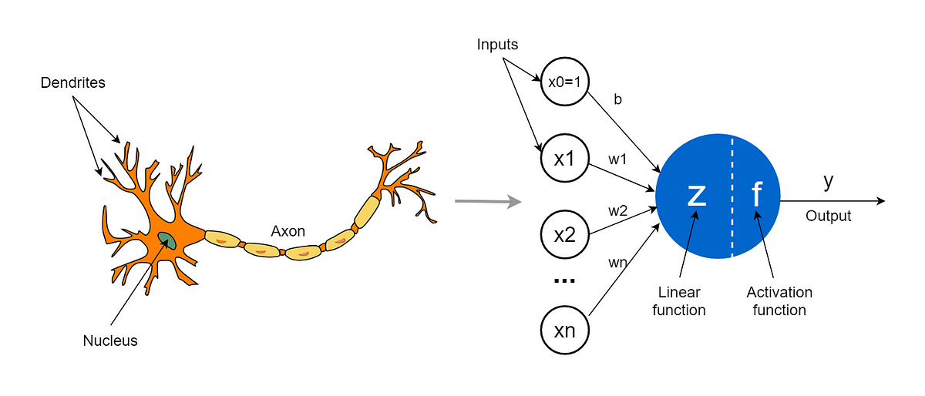
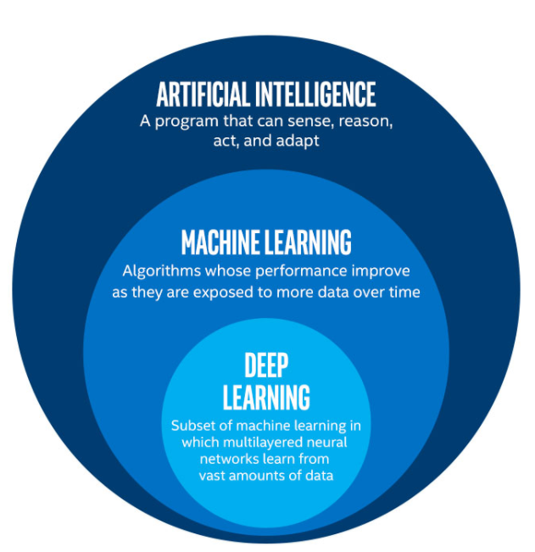
Deep Learning: what?
subfield of machine learning
focuses on the development and training of artificial neural networks
inspired by the structure and functioning of the human brain
capable of automatically learning and extracting meaningful representations from complex data, without explicit programming

Slide 4
Applications
Computer Vision
Natural Language Processing (NLP)
Speech Recognition
Autonomous Vehicles
Healthcare
Robotics
Recommender Systems
Finance and Trading

Slide 5
Some Necessary Programming concepts

Slide 6
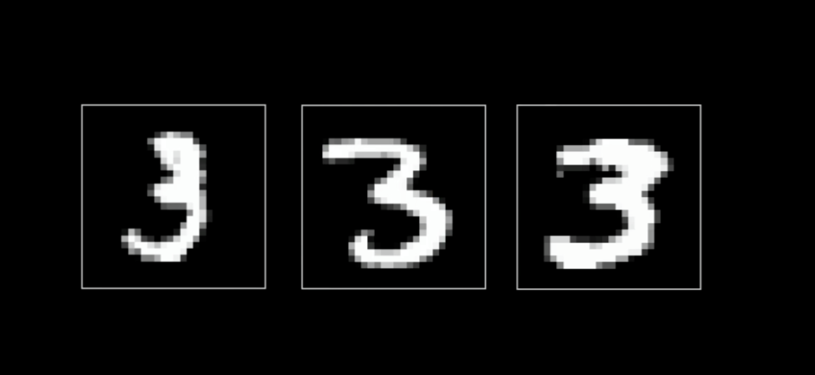

Slide 7
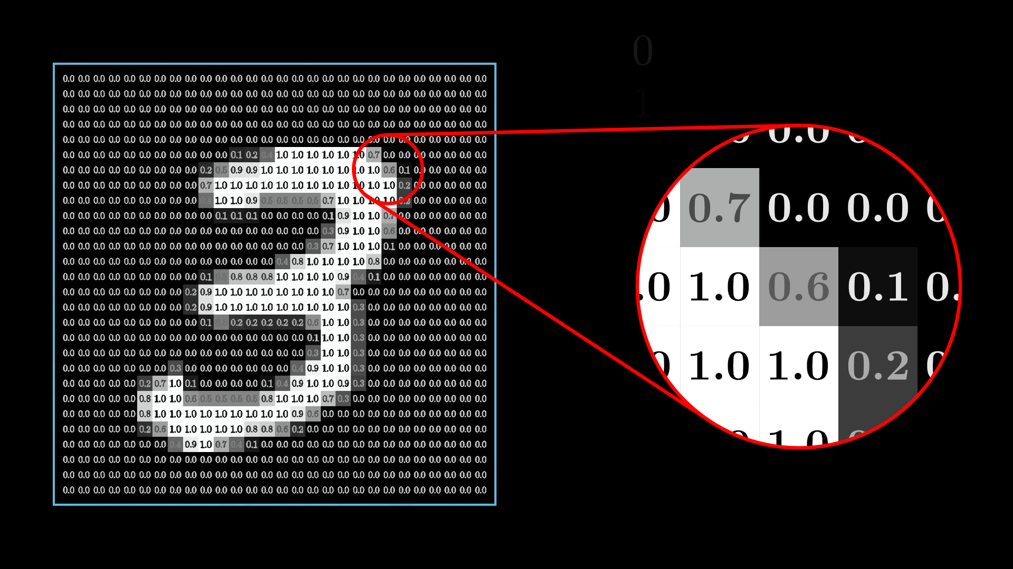

Slide 8
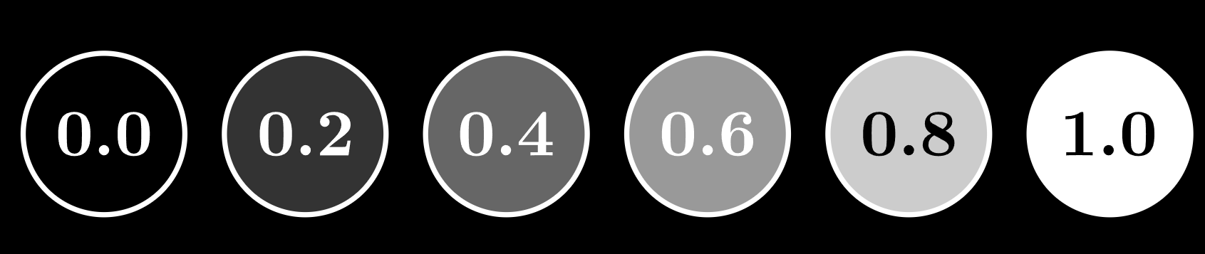

Slide 9
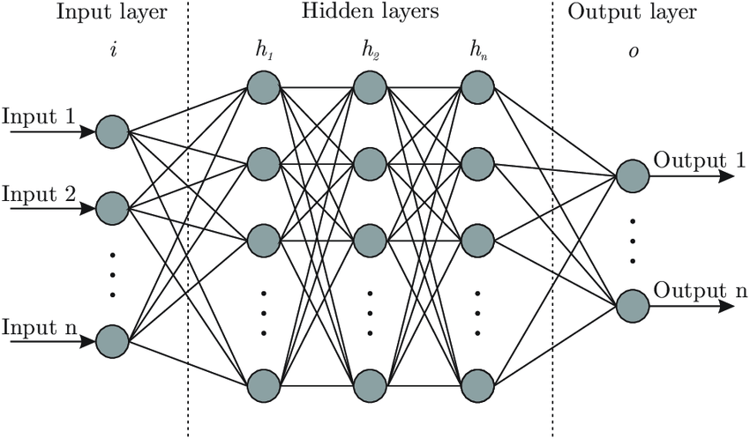

Slide 10
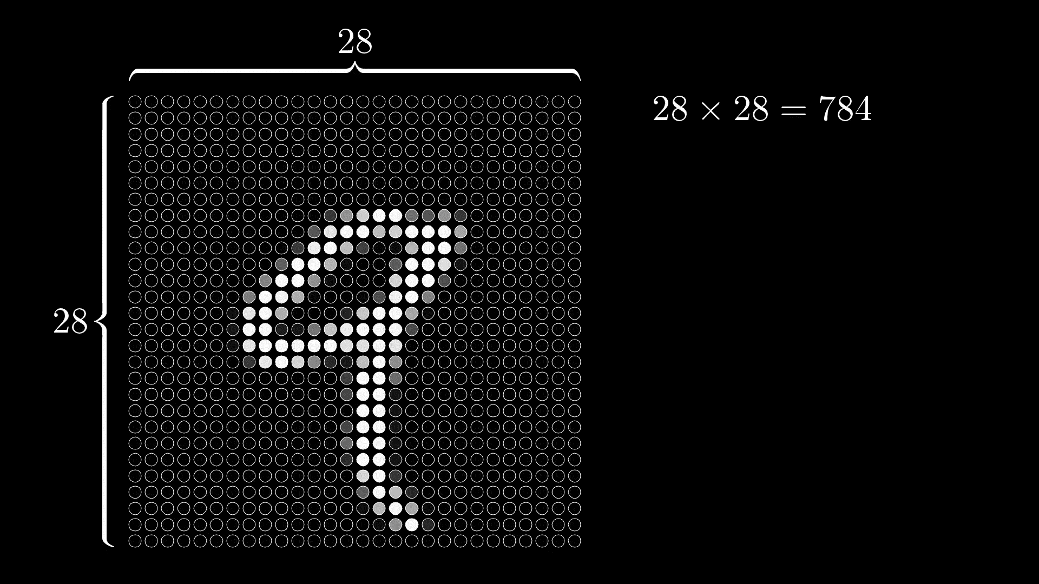

Slide 11
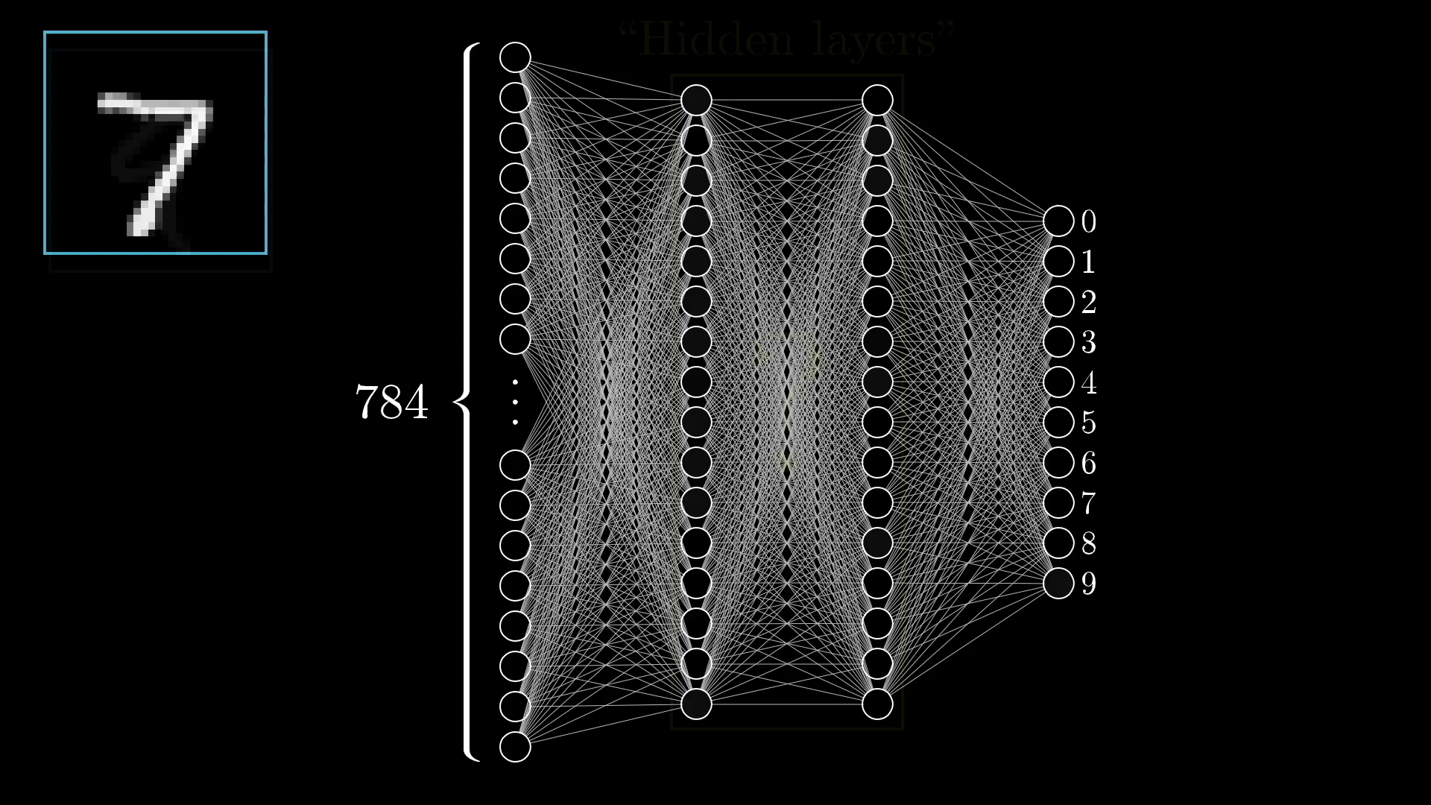

Slide 12
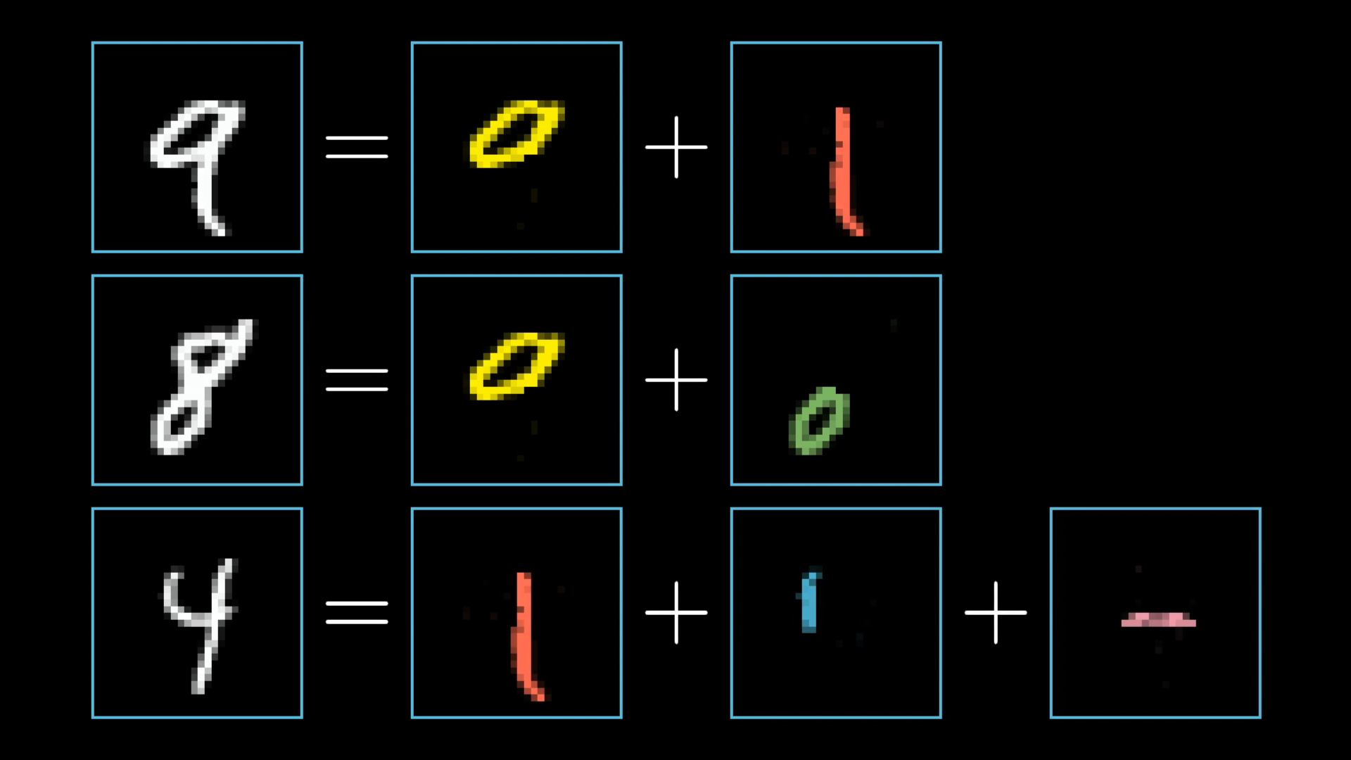

Slide 13
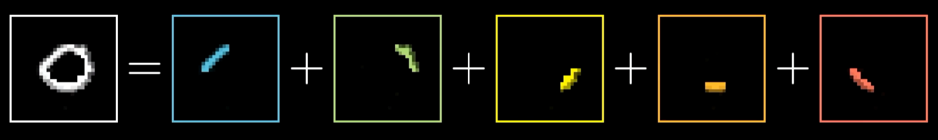

Slide 14
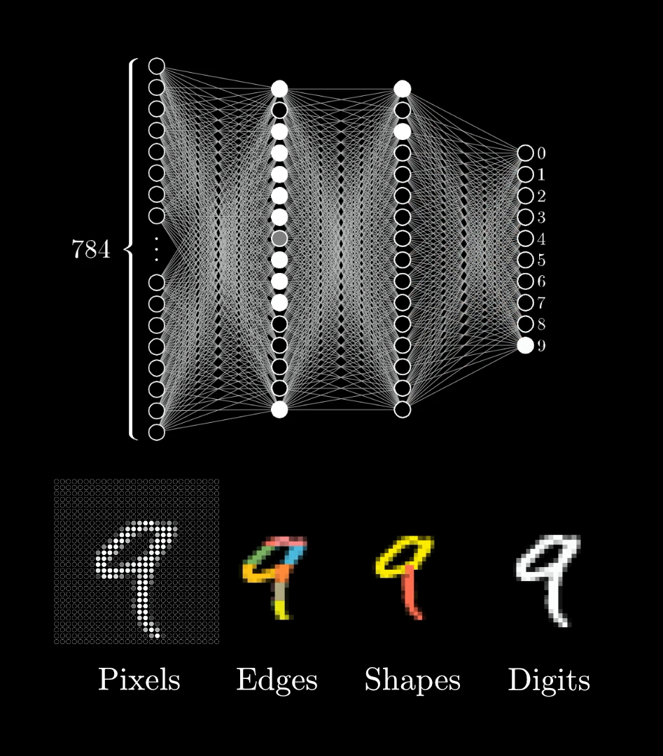

Slide 15
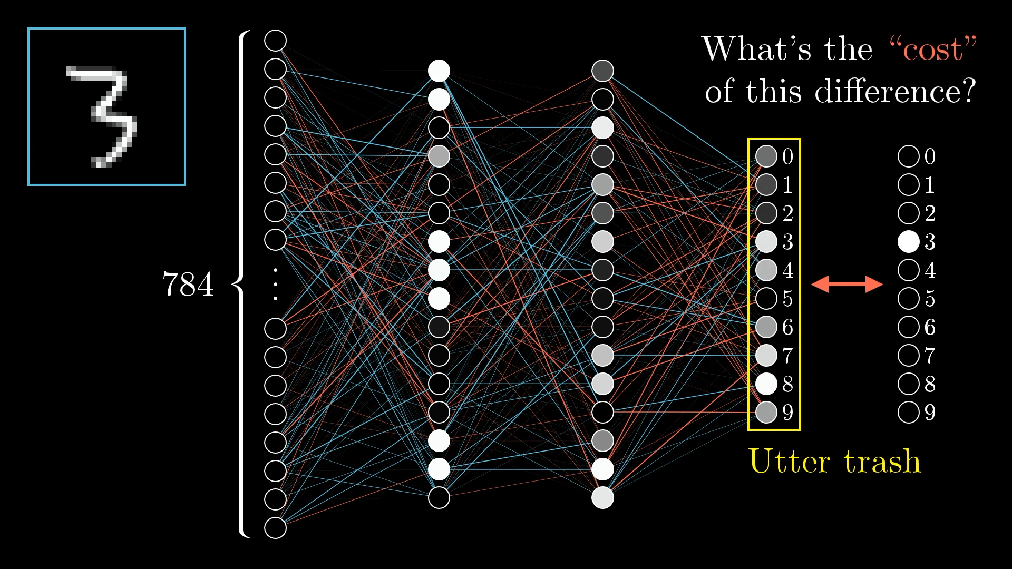

Slide 16
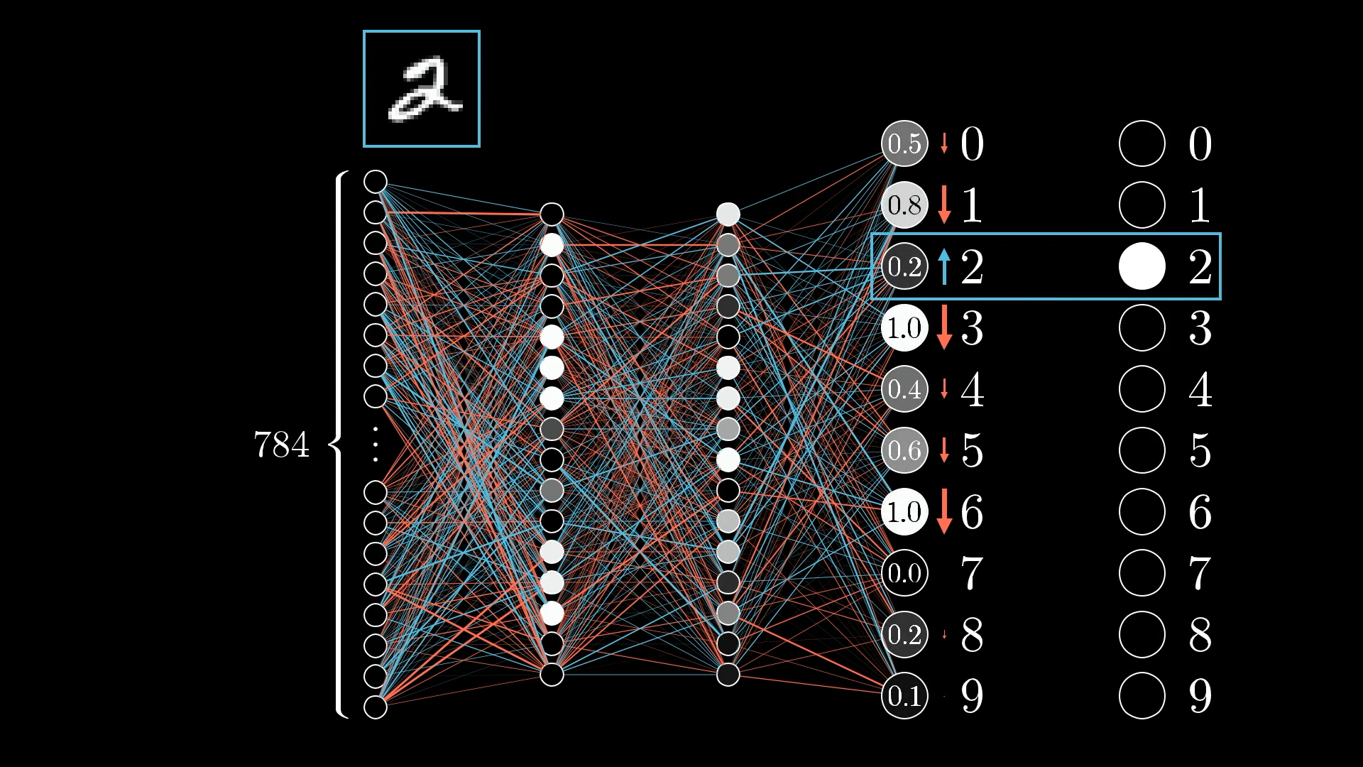

Slide 17
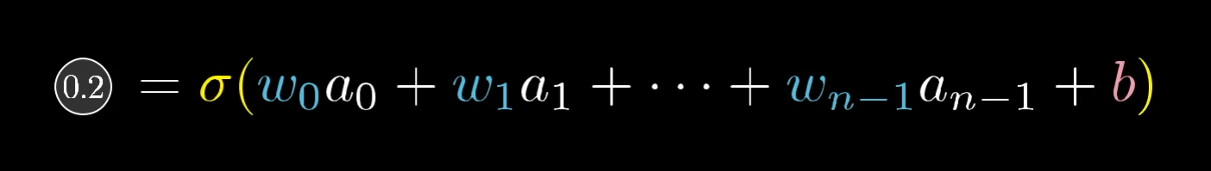

Slide 19
